Slide 1
PIPEMB, an integrated workflow for a short genomic variant discovery
LBBC – INCA
Rio de Janeiro
October-2021
Elvismary Molina de Armas (Ema) Prof. Sérgio Lifschitz
PUC-RIO
Mariana Boroni
Nicole Scherer
INCA

Slide 2
Summary
Motivation:
Variant calling workflow. PIPEMB
GATK: Best Practices, GATK and Picard, workflows
WDL + Cromwell
PIPEMB-WDL workflow. Construction process:
WDL coding
Installation
Infrastructure points
Execution:
Input sequence files
JSON file. Common options
Slurm script (command execution)
Execution time, output log (when you know that everything was successful)
Output directory
Tips to understand your results:
Differences in filters
What is the next..?

Slide 3
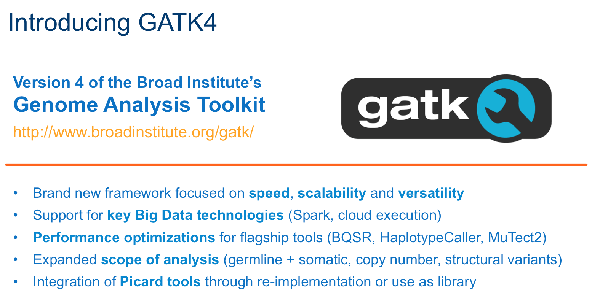
GATK 3. Best Practices
Short variant discovering (SNP and INDEL)
Pre-processing
from raw sequence reads (FASTQ files) to aligned reads (BAM files)
Variant discovery
from aligned reads (BAM files) to variants (VCF files)
Refinement and evaluation
Variant filtering, genotype refinement, functional annotation
Notes:
Tools de ferramentas
Secuencia de passos estableciendo entradas e salidas e ferramentas a serem usadas.
implementãção. (?)

Slide 4
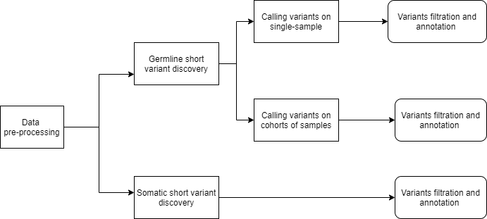
PIPEMB workflow. Main conceptual model.
Short variant discovering (SNP and INDEL)

Slide 5
PIPEMB workflow. Main conceptual model.
Pre-processing
Variant discovery
Refinement and evaluation

Slide 6
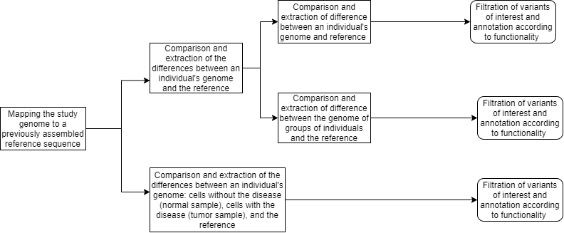
PIPEMB workflow. Main conceptual model.
Pre-processing
Variant discovery
Refinement and evaluation

Slide 7
PIPE-MB (GATK V3). Implementation.
Fastq
BAM
BAM to Fastq
Análise de Qualidade
Fastq to SAM
Marcação de Duplicatas
Alinhamento
uBAM to Fastq
Identificação de Adaptadores
2 amostras (T e N)
Realinhamento de Indels
Recalibração de Bases
Análise de Cobertura
BAM
SIM
MuTect
Anotação do efeito da variante
NÃO
Cohort e WGS
(Mais de 100 amostras)
Snpcall
SIM
filter.sh
NÃO
Source. Slides from ppt of Priscila de Sousa Ferreira
Rio de Janeiro, 18/03/2019
hard_filter.sh
Separando as amostras
Notes:
Germeline e somatico

Slide 8
Notes:
https://gatkforums.broadinstitute.org/gatk/discussion/9644/unboxing-gatk4

Slide 9
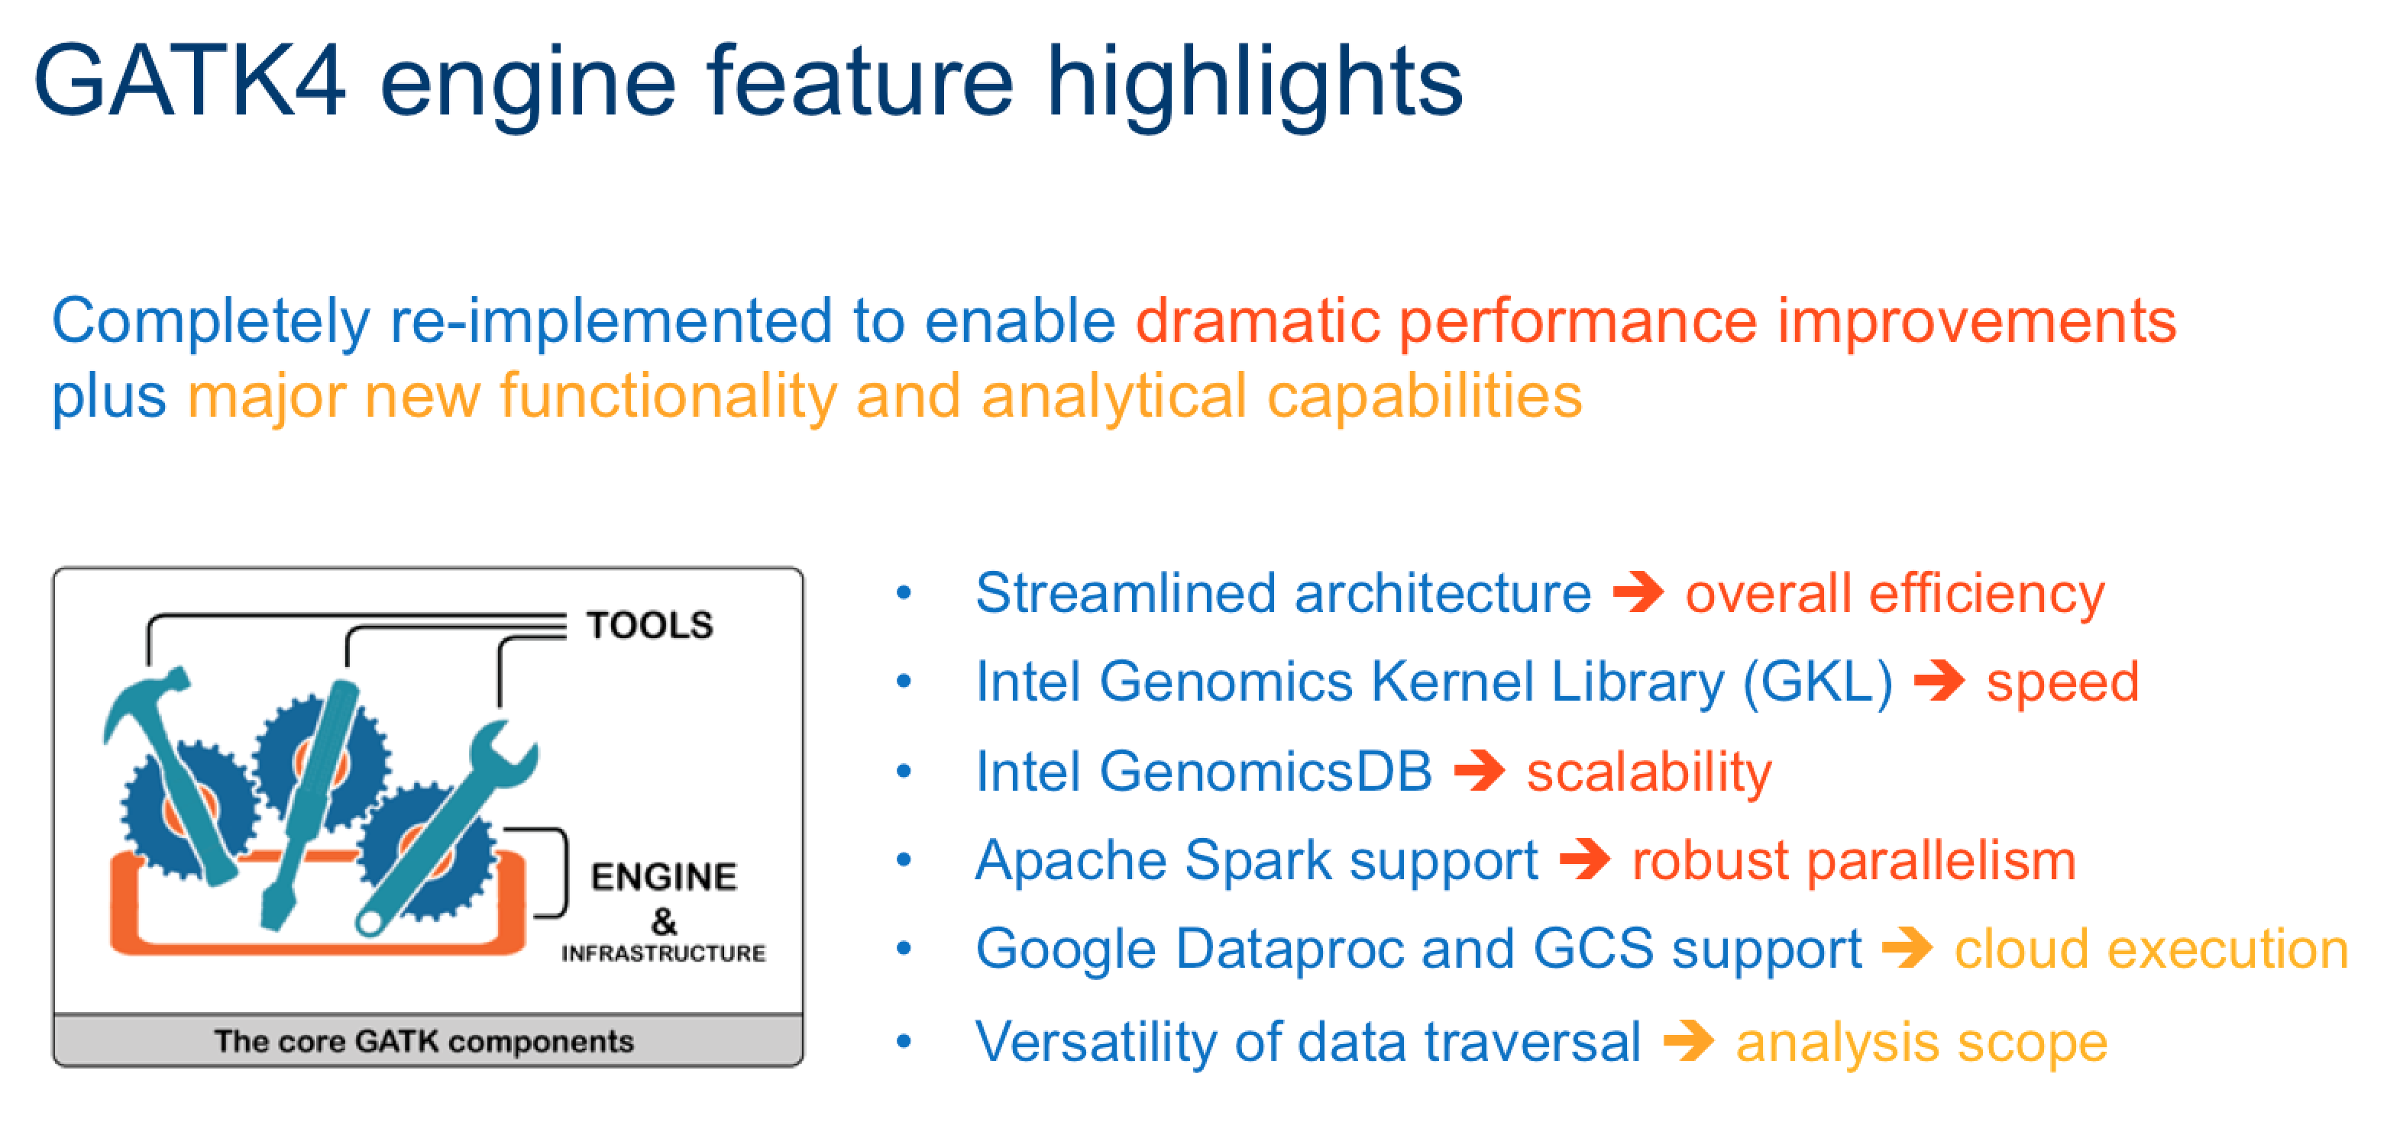

Slide 10
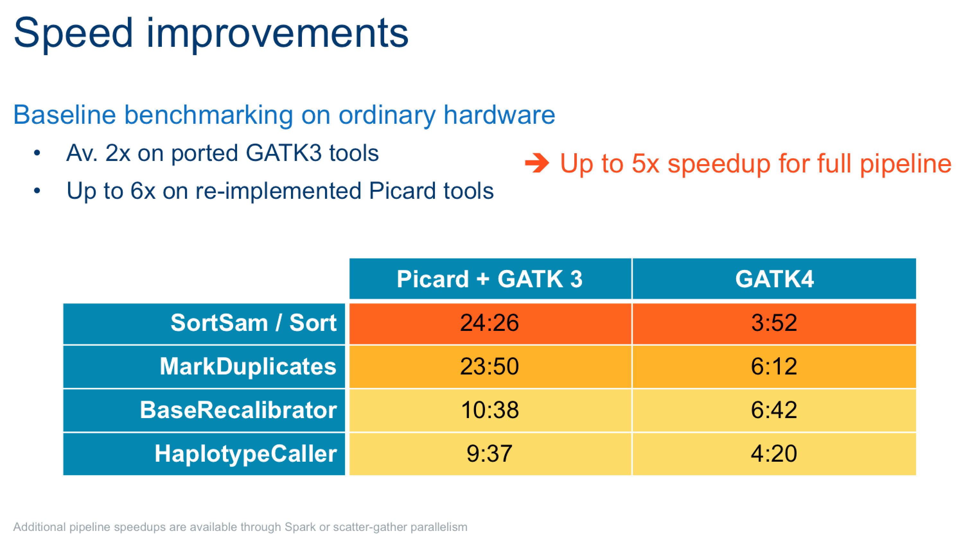

Slide 11
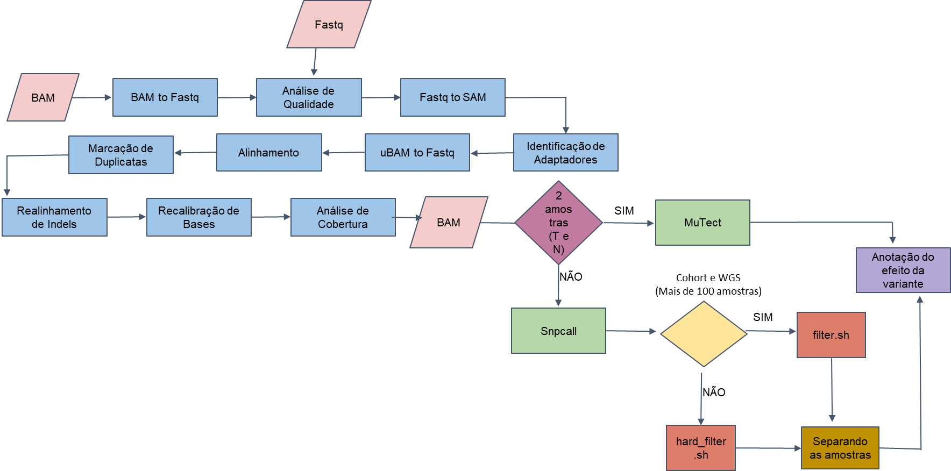
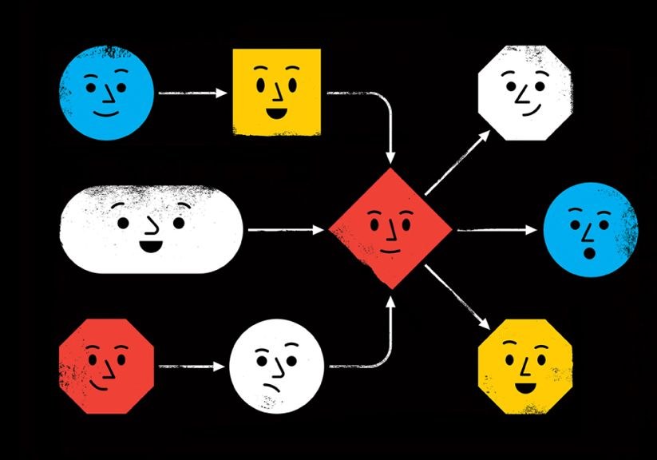

Main motivation
How to?
Be able to take advantage of the improvements in GATK 4.
Reproducible (provenance)
Allow flexibility to adapt to new changes (new versions, new recommendations)
Easy to change tools
Easy to maintenance
Easy to scale
GATK 3
Tools
Best Practices
Tools
Best Practices
Execution infrastructure + Workflow description languague

Slide 12
Workflow Description Language (WDL)
https://github.com/openwdl/wdl/blob/main/versions/1.0/SPEC.md#arrayarraystring-read_tsvstringfile
workflow wf {
input{
}
call hello
{
input:….
}
call task1
{
input:....
}
output{
Array[String] wf_out = hello. matches
}
}
task hello {
input {
String pattern
File in
}
command {
egrep '${pattern}' '${in}'
}
runtime {
docker: "broadinstitute/my_image"
}
output {
Array[String] matches = read_lines(stdout())
}
}
if:
scatter:
Notes:
The Workflow Description Language (WDL) is a way to specify data processing workflows with a human-readable and writeable syntax. WDL makes it straightforward to define complex analysis tasks, chain them together in workflows, and parallelize their execution. The language makes common patterns simple to express, while also admitting uncommon or complicated behavior; and strives to achieve portability not only across execution platforms, but also different types of users. Whether one is an analyst, a programmer, an operator of a production system, or any other sort of user, WDL should be accessible and understandable.

Slide 13
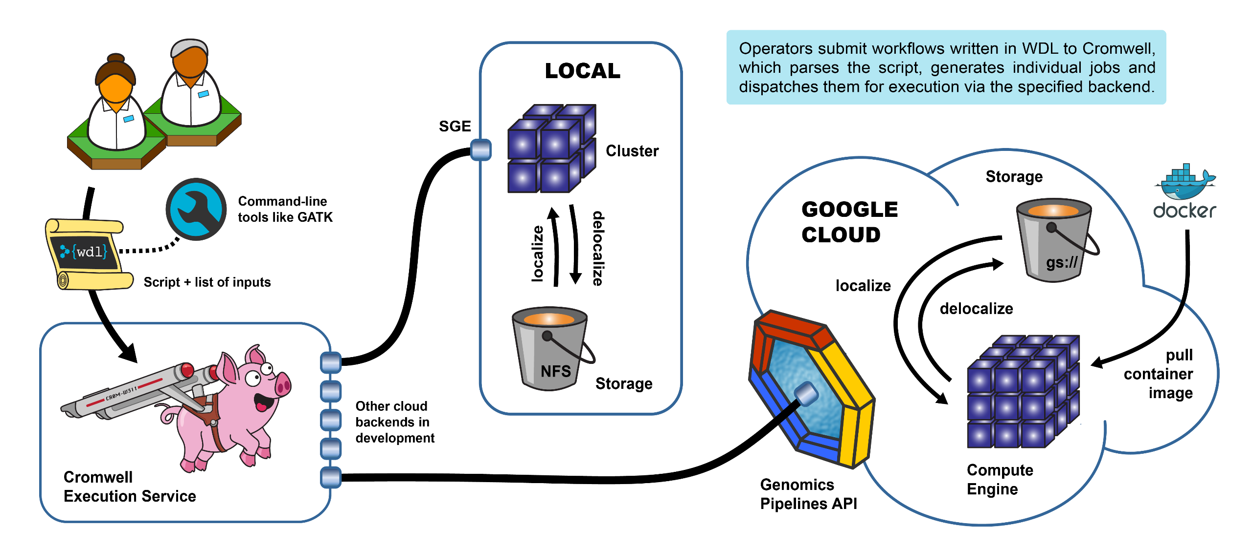
Cromwell + WDL
https://gatk.broadinstitute.org/hc/en-us/articles/360035889771-Pipelining-GATK-with-WDL-and-Cromwell

Slide 14
Summary
Motivation:
Variant calling workflow. PIPEMB
GATK: Best Practices, GATK and Picard, workflows
WDL + Cromwell
PIPEMB-WDL workflow. Construction process.
WDL coding
Installation
Infrastructure points
Execution:
Input sequence files
JSON file. Common options
Slurm script (command execution)
Execution time, output log (when you know that everything was successful)
Output directory
Tips to understand your results:
Differences in filters
What is the next..?

Slide 15
PIPEMB workflow main conceptual model
Pre-processing
Variant discovery
Refinement and evaluation

Slide 16
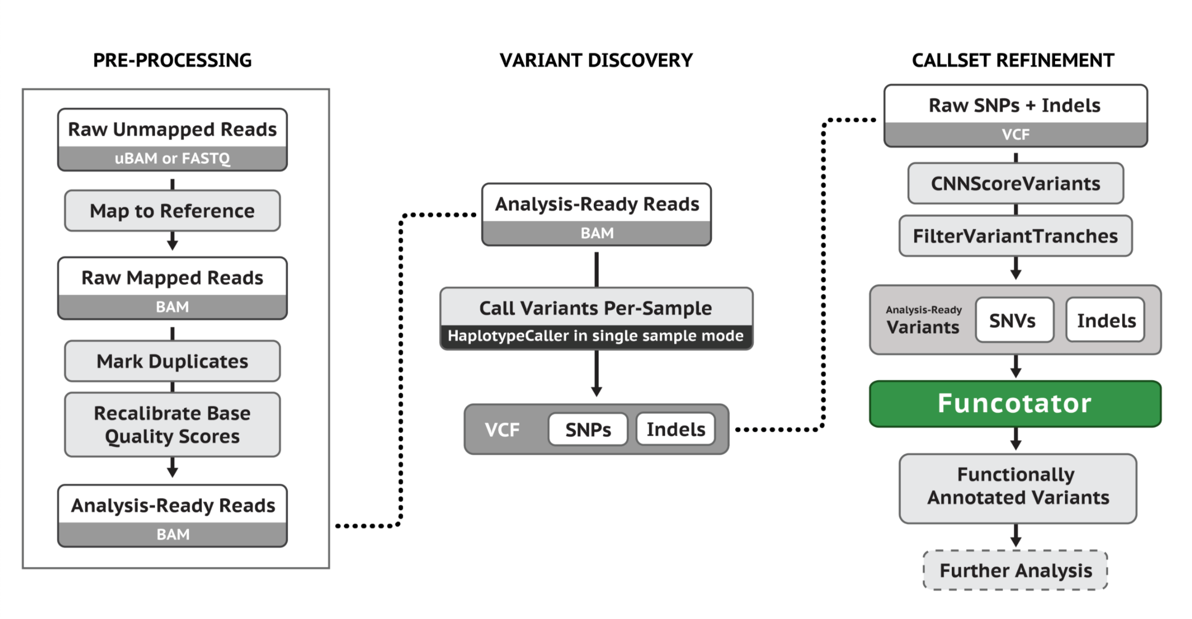
Main steps for Germline Single-Sample Data
https://gatk.broadinstitute.org/hc/en-us/articles/360035535932-Germline-short-variant-discovery-SNPs-Indels-

Slide 17
PIPEMB workflow main conceptual model
Pre-processing
Variant discovery
Refinement and evaluation

Slide 18
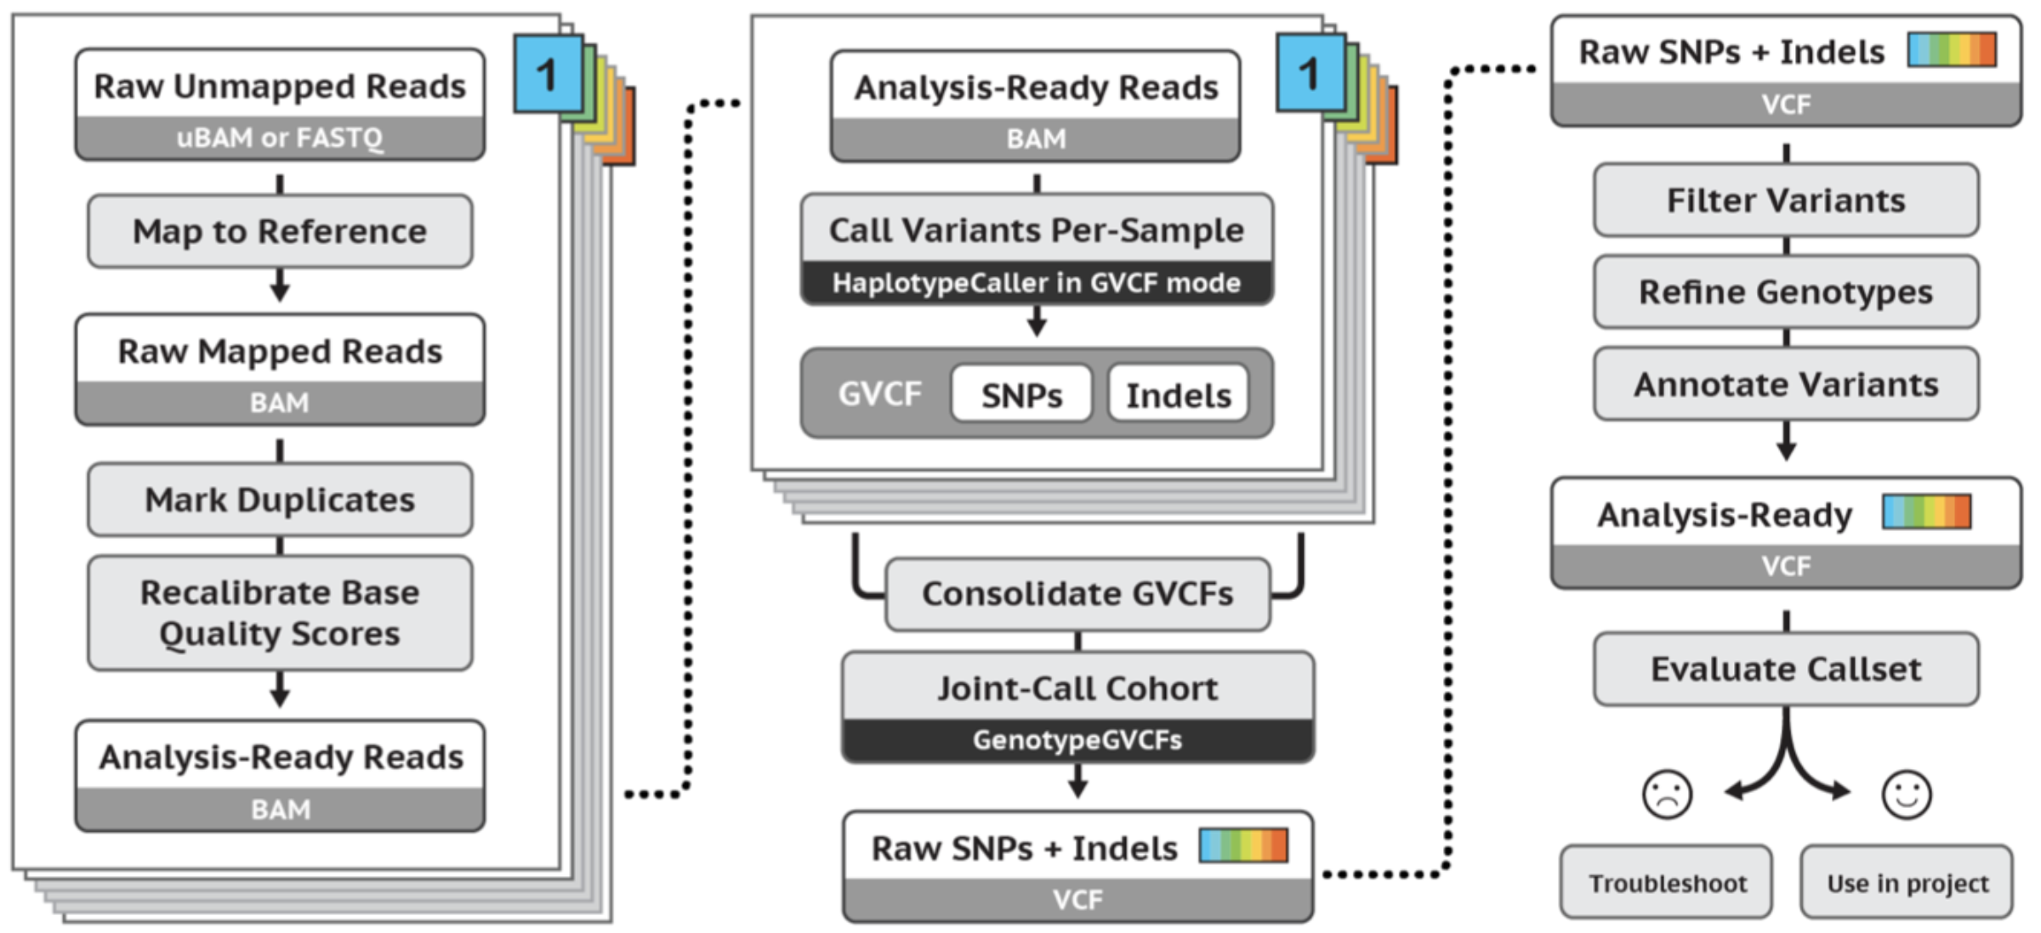
Main steps for Germline Cohort Data
https://gatk.broadinstitute.org/hc/en-us/articles/360035535932-Germline-short-variant-discovery-SNPs-Indels-

Slide 19
PIPEMB workflow main conceptual model
Pre-processing
Variant discovery
Refinement and evaluation

Slide 20
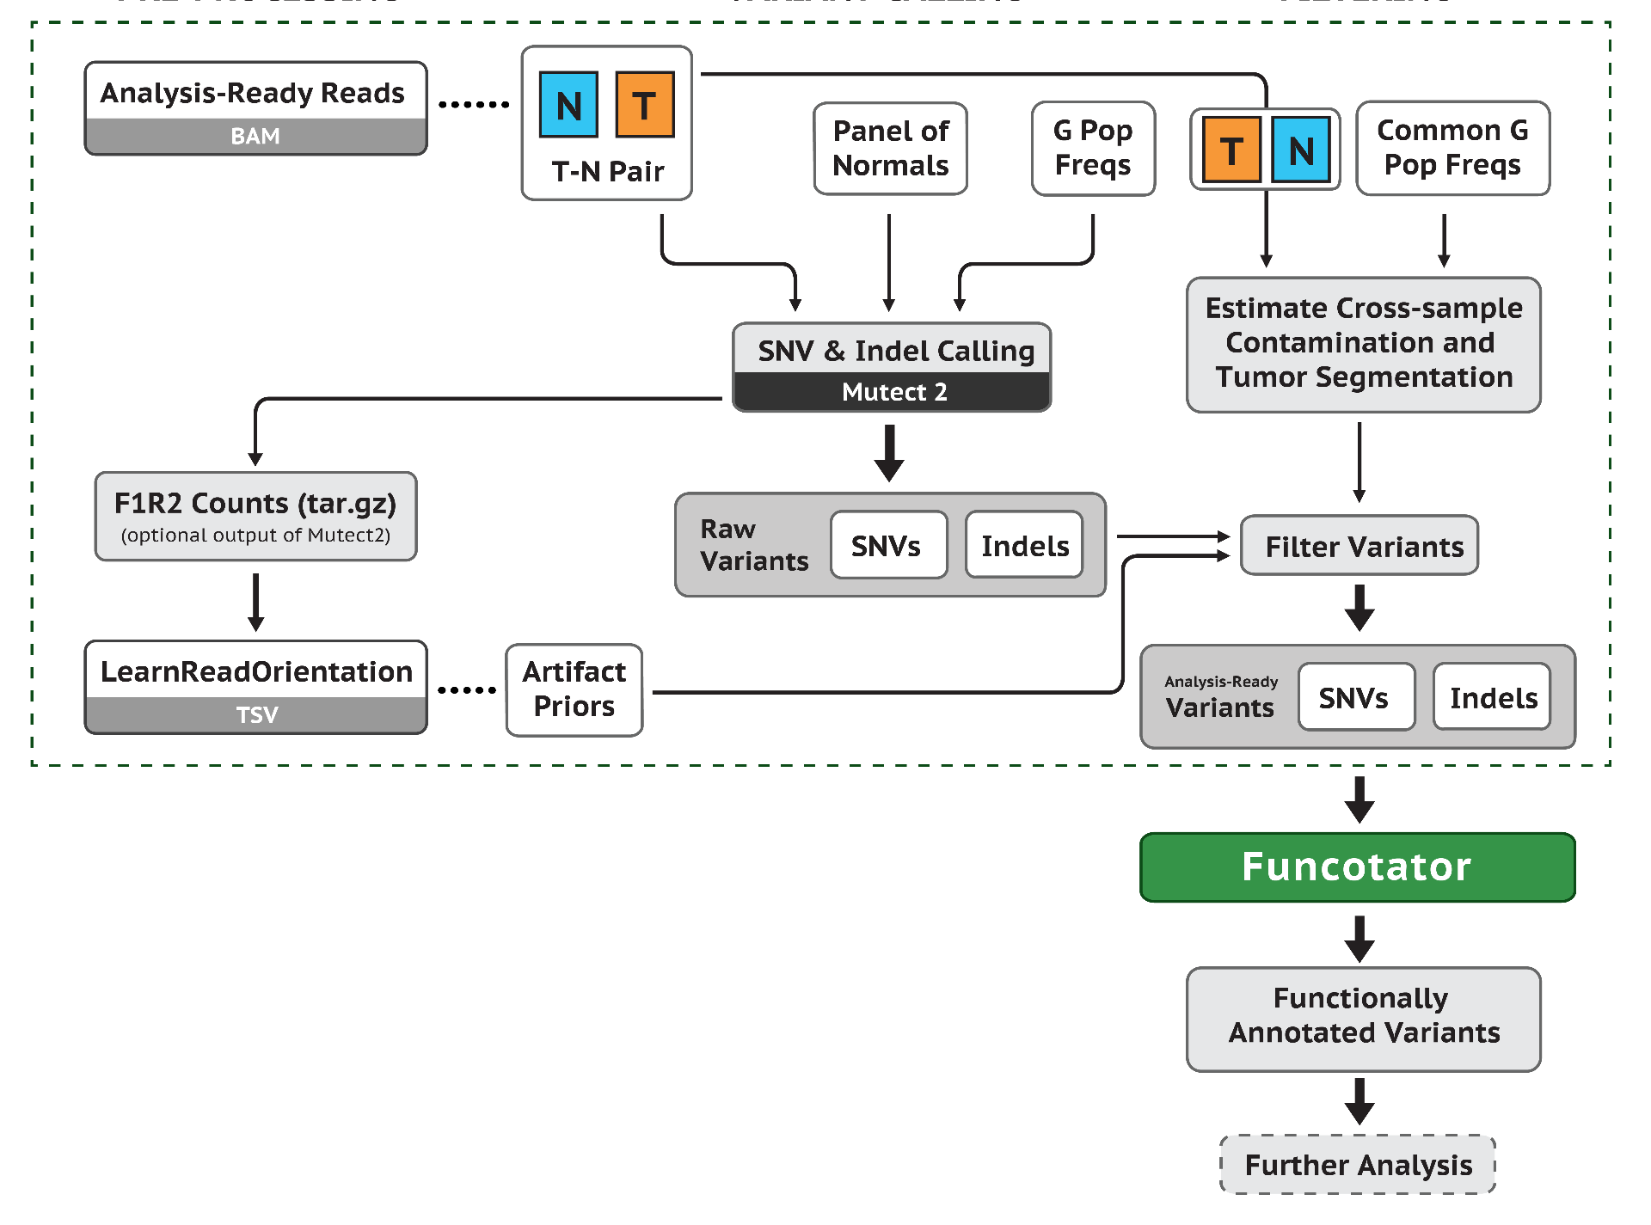
Somatic short variant discovery (SNVs + Indels)
https://gatk.broadinstitute.org/hc/en-us/articles/360035535932-Germline-short-variant-discovery-SNPs-Indels-

Slide 21
Available implementations (GATK workflows)
gatk4-germline-snps-indels.
haplotypecaller.wdl
gatk4-germline-snps-indels.
JointGenotyping.wdl
There is no integration between the different implementations.
Validation is not included in all cases.
Does not take fastq input into account.
Does not include adapter marking.
Multi-sample processing is not automated.
gatk4-data-processing. processing-for-variant-discovery-gatk4.wdl
gatk4-somatic-snvs-indels.
mutect2_pon.wdl
gatk4-somatic-snvs-indels.
mutect2.wdl
Notes:
Nada disso esta conetado

Slide 22
Available implementations (gatk workflows)
n samples
gatk4-germline-snps-indels.
haplotypecaller.wdl
...
There is no integration between the different implementations.
Validation is not included in all cases.
Does not take fastq input into account.
Does not include adapter marking.
Multi-sample processing is not automated.
gatk4-germline-snps-indels.
JointGenotyping.wdl
n executions,
1 per sample
n samples
gatk4-data-processing. processing-for-variant-discovery-gatk4.wdl
n executions,
1 per sample
...
gatk4-somatic-snvs-indels.
mutect2_pon.wdl
gatk4-somatic-snvs-indels.
mutect2.wdl
Notes:
Nada disso esta conetado

Slide 23
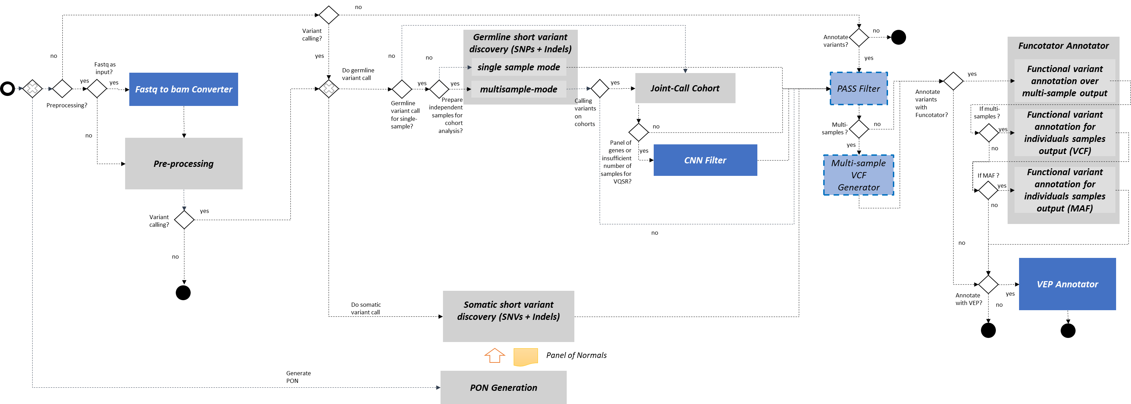
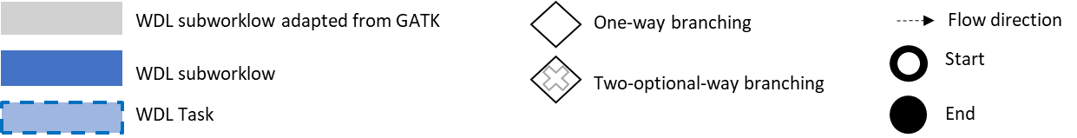
PIPEMB-WDL. Main implementation components and execution flow.
Legend:

Slide 24
PIPEMB workflow main conceptual model
Pre-processing
Variant discovery
Refinement and evaluation

Slide 25
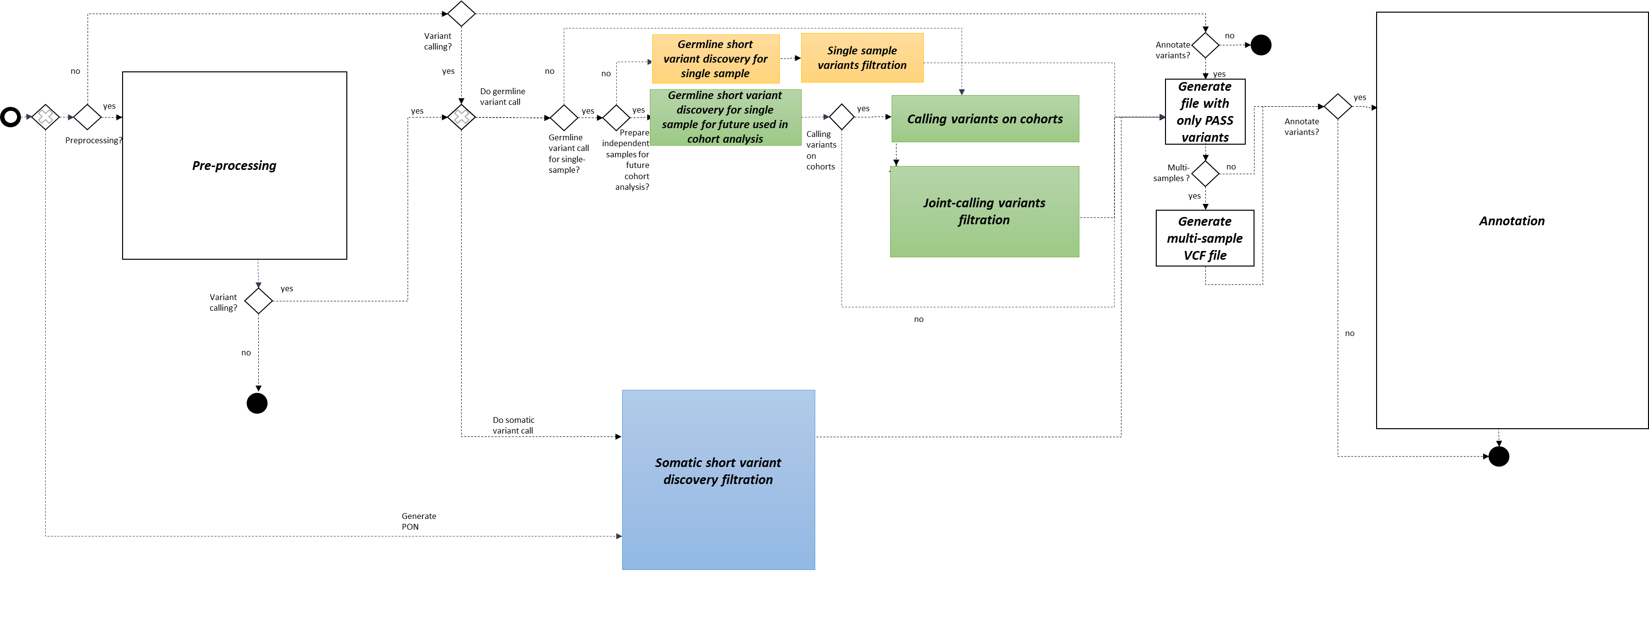
Workflow. Funcionalidades (nivel 1)

Slide 26
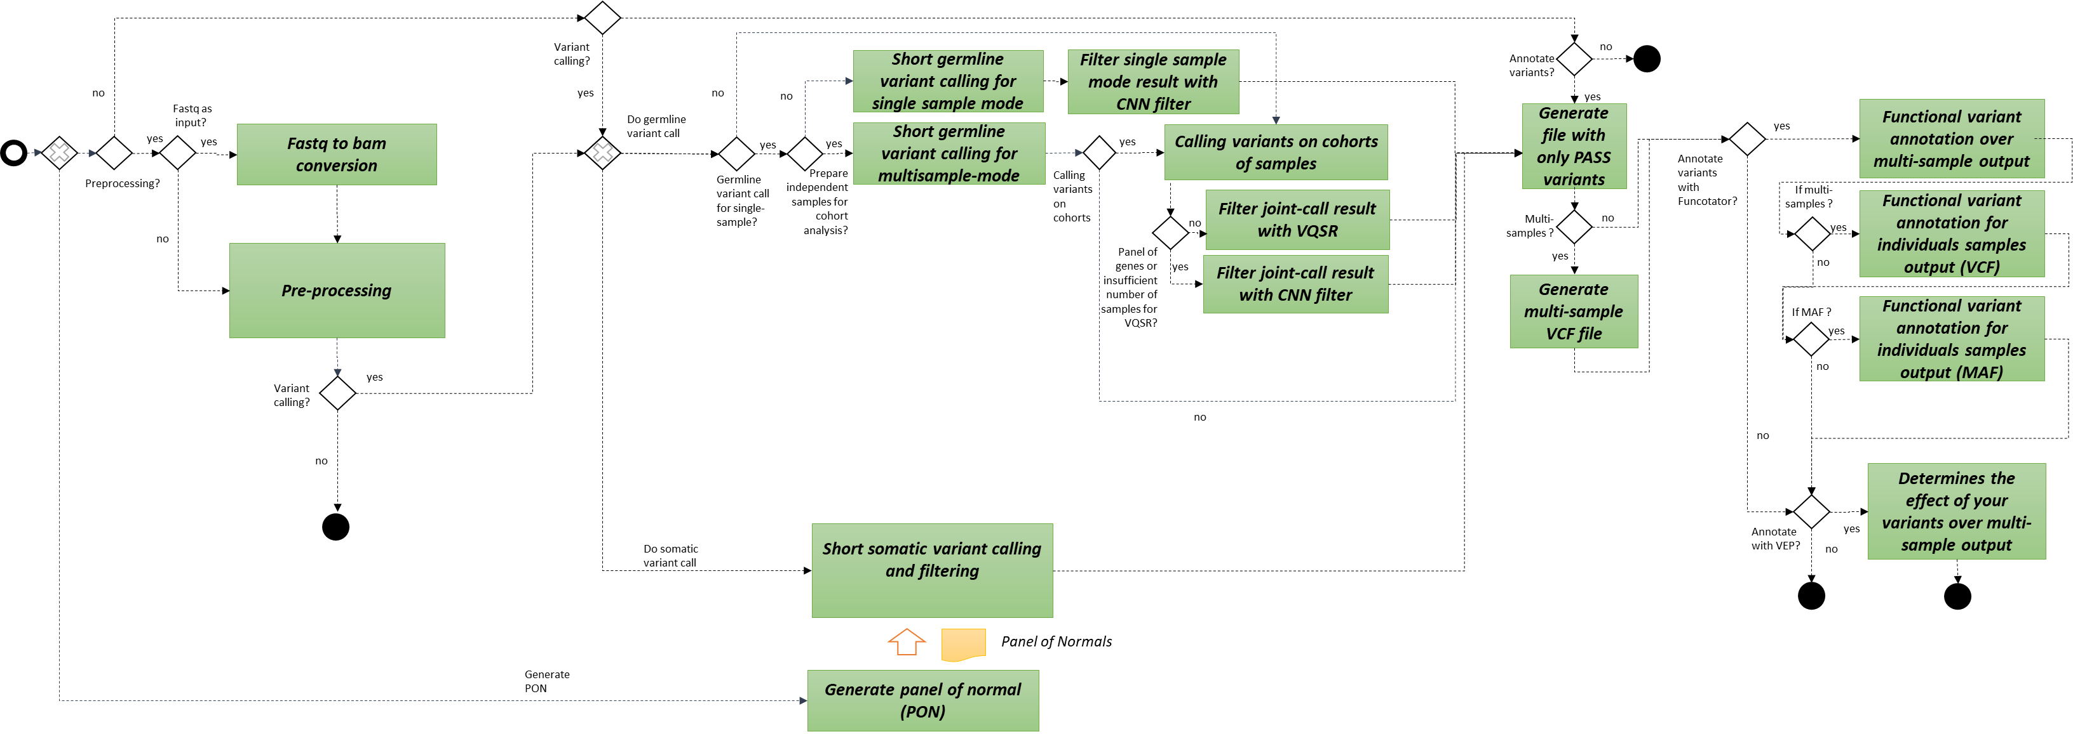
Workflow. Functionalities

Slide 27
Workflow. Functionalities
Pre-processing

Slide 28
Workflow. Functionalities
Variant discovery

Slide 29
Workflow. Functionalities
Refinement and evaluation

Slide 30
Challenges
WDL coding:
Lack of a language-specific IDE.
Language under development, with a mix of draft-1, draft-2 and draft-3 versions, and the current version 1.0. Incompatibility to integrate sub-workflows with different versions.
Periodic updates from Cromwell to run WDL.
Independent data directories between tasks (containers). The passage of input files for each task has to be with data type File.
Redundancy of files copied multiple times during a workflow run.
Existence of optional data types (use of "?", For example File and File?). The use of the select_first and select_all.
There is no “null” or “None” .
Impossibility to change the value of an attribute once set, the declaration of the variable is linked to the value assignment.
Conditionals without the option of the “else” block. Alternative use of select_first and select_all.
The type of output when using scatter when calling a task becomes Array.
Does not allow nested scatter.
Configuration and deployment: Slurm + Singularity + Cromwell
Support launching in Docker containers.
How to differentiate the infra for different tasks. Optional bindings.
Workload manager integration. Cromwell submitting jobs to Slurm.
How does Slurm know when a job has been completed?
Overcome the problem of Docker limit rate.

Slide 31
Summary
Motivation:
Variant calling workflow. PIPEMB
GATK: Best Practices, GATK and Picard, workflows
WDL + Cromwell
PIPEMB-WDL workflow. Construction process.
WDL coding
Installation
Infrastructure points
Execution:
Input sequence files
JSON file. Common options
Slurm script (command execution)
Execution time, output log (when you know that everything was successful)
Output directory
Tips to understand your results:
Differences in filters
What is the next..?

Slide 32
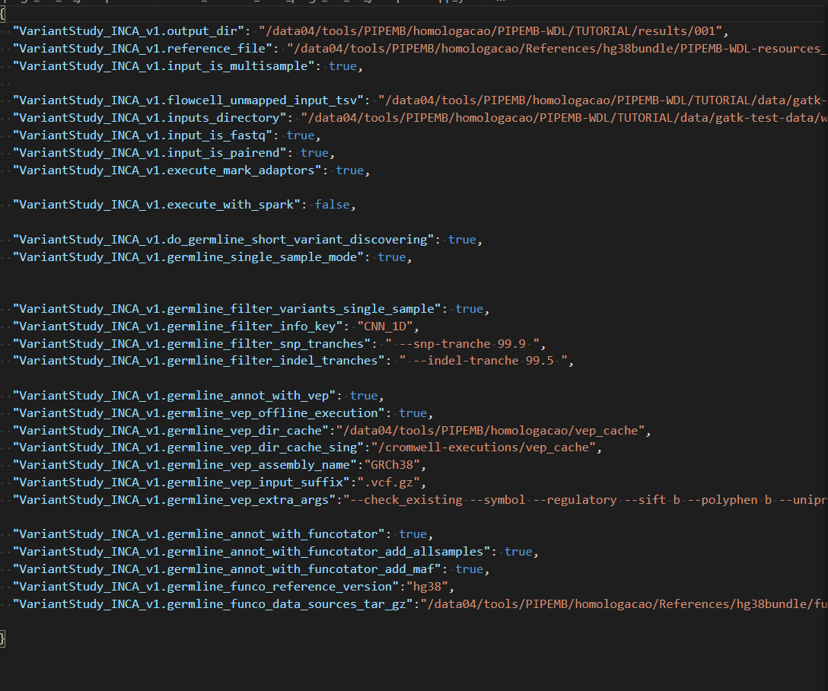
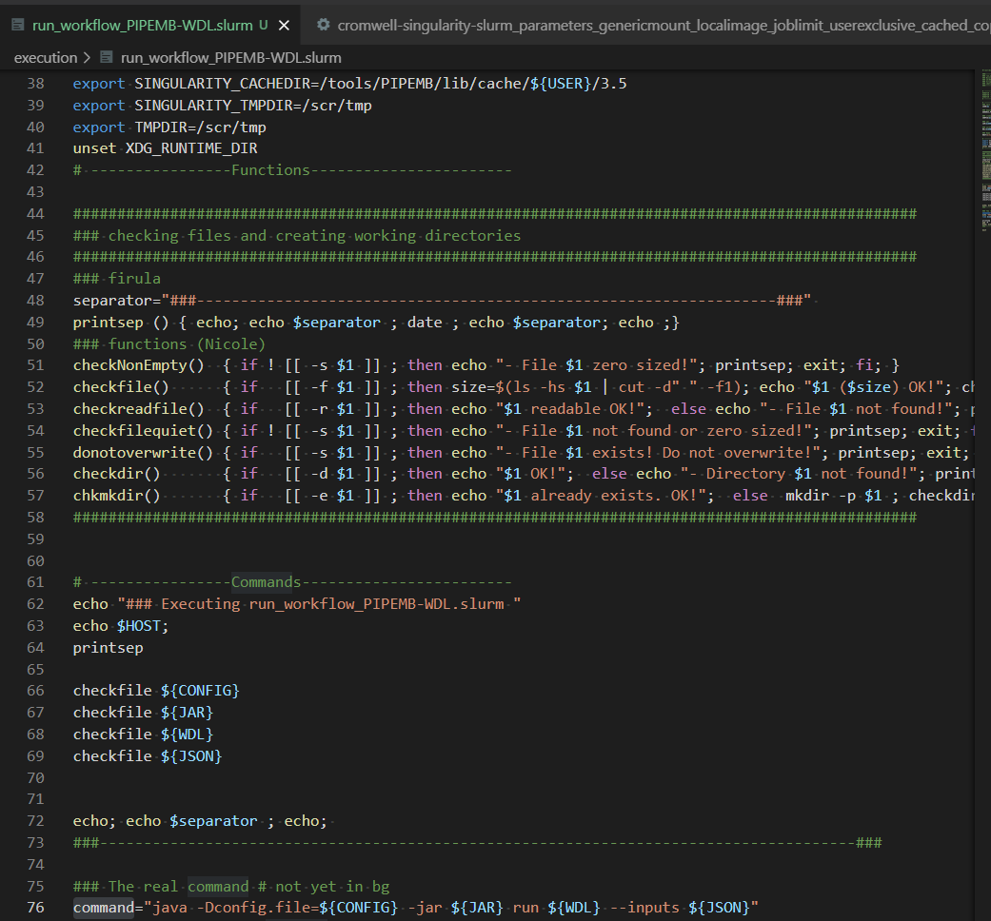
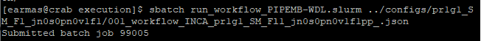
Execution
multisample_multipleRG_fastq.tsv
group1 /../data/a_R1.fastq /…/data/a_R2.fastq 1 SAMPLE1 ILLUMINA lib01 paired
group2 /../data/b_R1.fastq /../data/b_R2.fastq 2 SAMPLE1 ILLUMINA lib01 paired
group1 /../data/c_R1.fastq /../data/c_R2.fastq 3 SAMPLE2 ILLUMINA lib01 paired
group2 /../data/d_R1.fastq /../data/d_R2.fastq 4 SAMPLE2 ILLUMINA lib01 paired
JSON (parameters)
run_workflow_PIPEMB-WDL.slurm
https://github.com/BioBD/PIPEMB-WDL

Slide 33
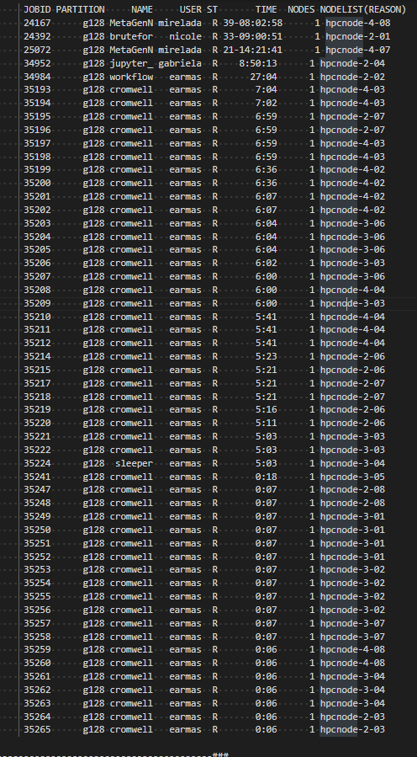
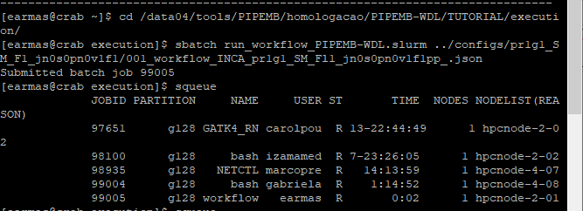
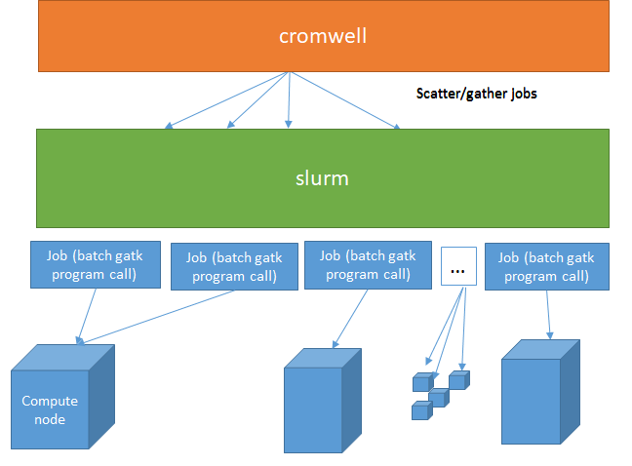
Execution

Slide 34
Common flows executed
Name convention for template configurations:
pr1g1_SM_Fl_jn0s0pn0f1v1:
0: disabled , 1: enabled
pr: pre-processing
g:germline
SM: single sample mode
MM: multisample mode
Fl: filtering
jn: joint genotyping
s:somatic
pn: create panel of normal
f: filter with Funcotator
v: filter with VEP
++/pp:filter with Funcotator with optional MAF and VCF for independent samples

Slide 35
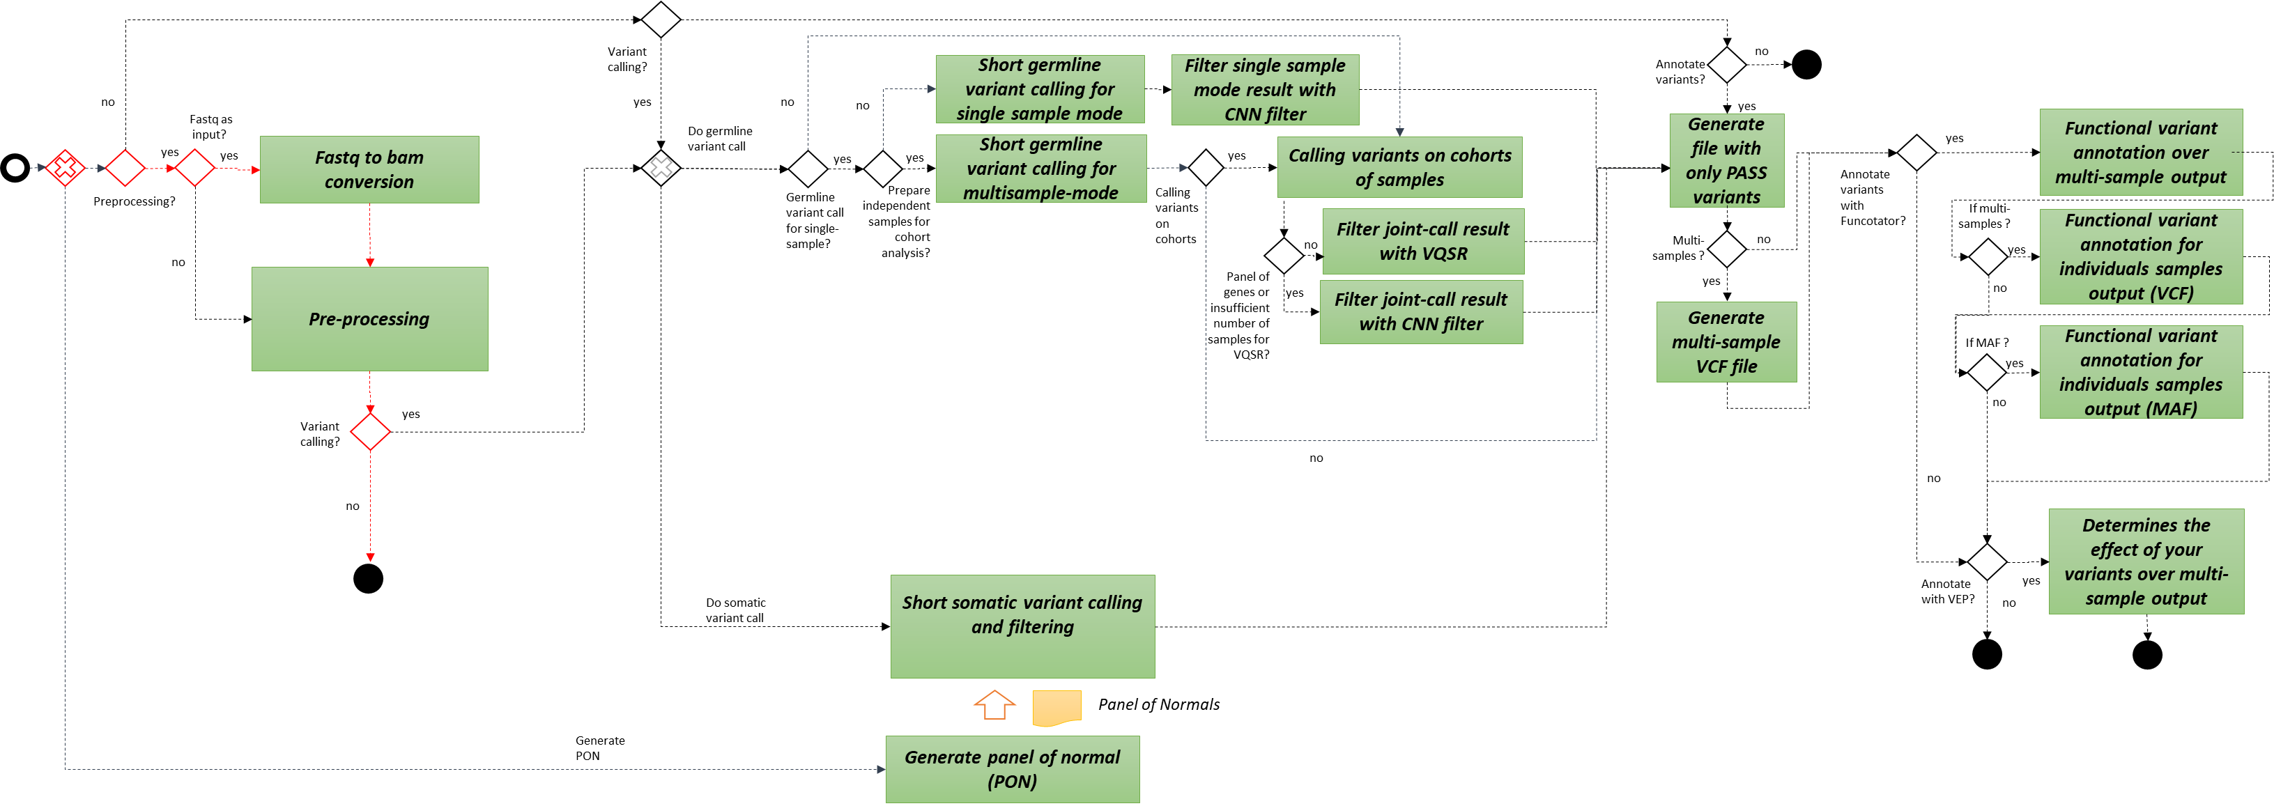
pr1g0jn0s0pn0f0v0

Slide 36
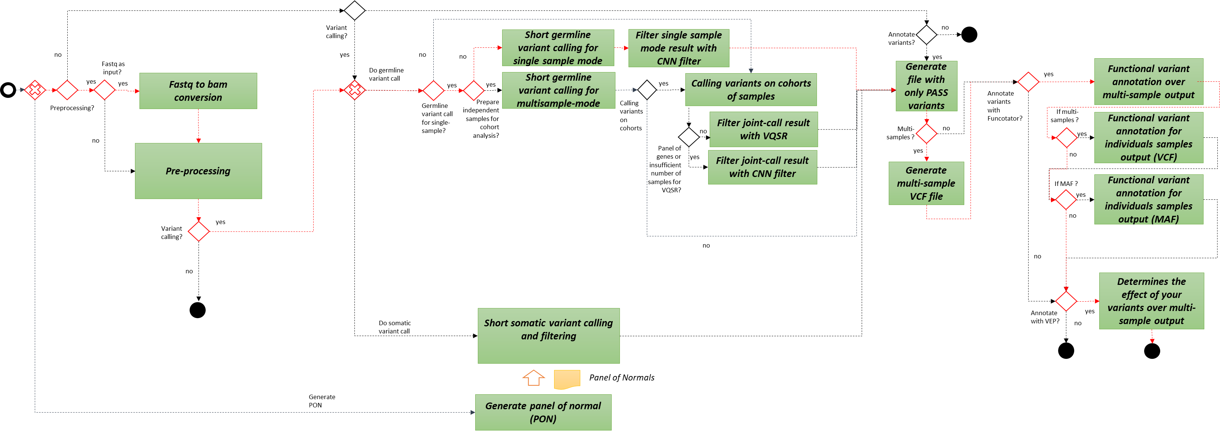
pr1g1_SM_Fl_jn0s0pn0f1v1

Slide 37

pr0g0jn0s1f1v1

Slide 38
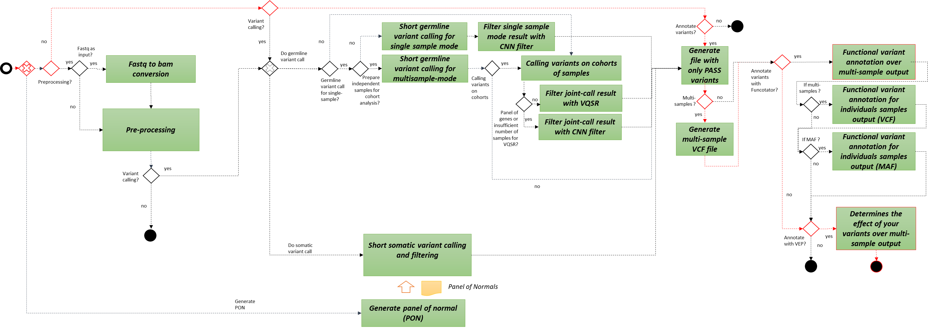
pr0g0jn0s0pn0f0v1

Slide 39
Execution
Tutorial:
Part 1. Presenting the structure of directories and JSON files.
Part 2.Executing
Part 3.Executing process. Output directory
Part 4. Output directory

Slide 40
Summary
Motivation:
Variant calling workflow. PIPEMB
GATK: Best Practices, GATK and Picard, workflows
WDL + Cromwell
PIPEMB-WDL workflow. Construction process.
WDL coding
Installation
Infrastructure points
Execution:
Input sequence files
JSON file. Common options
Slurm script (command execution)
Execution time, output log (when you know that everything was successful)
Output directory
Tips to understand your results:
Differences in filters
What is the next..?

Slide 41
Filtering
Processo | Tipo de estudo | Tipo de Sample | PIPE-MB v3 (script) | PIPE-MB v4 (Cromwell + Singularity + WDL)
Filter | Germline | Single sample | SelectVariant + VariantFiltration + CombineVariants | CNNScoreVariants + FIlterVariantTranches
 |  | Multisample | VariantRecalibrator + ApplyRecalibration | VariantRecalibrator + ApplyRecalibration
 | Somatic | - | - | FilterMutectCalls
Hard filter script:
Variant Quality Score Recalibration (VQSR)

Slide 42
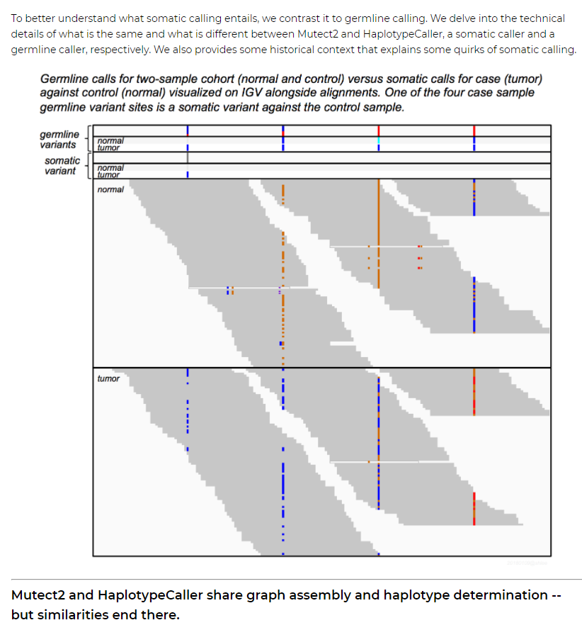
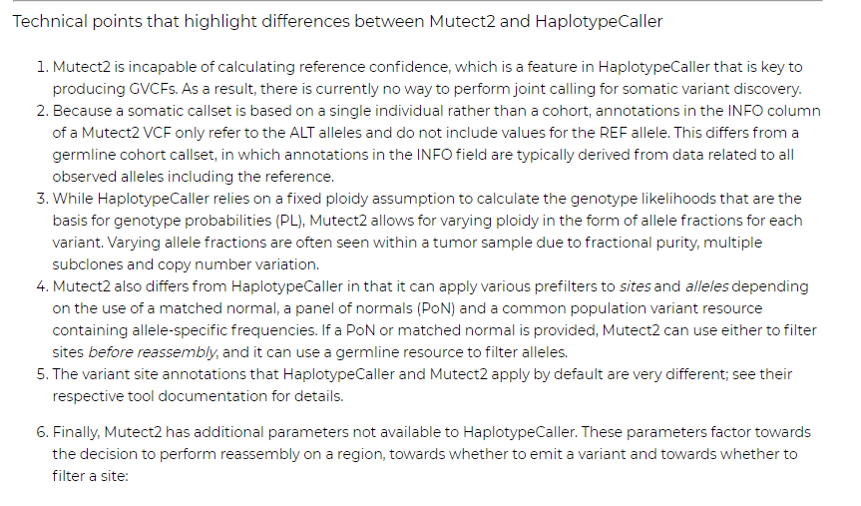
Germline and somatic calling software differences
https://gatk.broadinstitute.org/hc/en-us/articles/360035890491-Somatic-calling-is-NOT-simply-a-difference-between-two-callsets

Slide 43
Summary
Motivation:
Variant calling workflow. PIPEMB
GATK: Best Practices, GATK and Picard, workflows
WDL + Cromwell
PIPEMB-WDL workflow. Construction process.
WDL coding
Installation
Infrastructure points
Execution:
Input sequence files
JSON file. Common options
Slurm script (command execution)
Execution time, output log (when you know that everything was successful)
Output directory
Tips to understand your results:
Differences in filters
What is the next..?

Slide 44
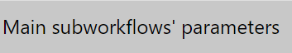
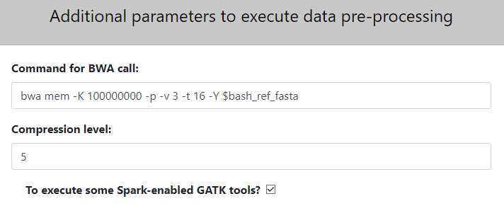
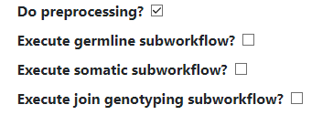

What is the next..?
Input parameters
Input sequences (ubam/fasta/fastq)
Mark adaptors?
Preprocessing ( - )
+
Is it an amplicon sequencing data?
Germline variant calling
JointGenotype variant calling
Somatic variant calling
PON generation
Annotation
upload
Are they paired-end sequences?
Input interval list for panel of genes (bed, intervals, list)
Is input format Fastq?
upload
Advanced parameters
Tipo de estudo
Whole genome
Exome
Panel of genes
Output parameters
Genoma de referencia
Output directory:
Hg38
b37/Hg19
Infra parameters
Use local images?
GATK image
/local_images/../..
GATK path
/gatk/gatk

Slide 45
PIPEMB, an integrated workflow for a short genomic variant discovery
LBBC – INCA
Rio de Janeiro
October-2021
Elvismary Molina de Armas (Ema) Prof. Sérgio Lifschitz
PUC-RIO
Mariana Boroni
Nicole Scherer
INCA

